Slide 1
Dreaming in Taglish?

Slide 2
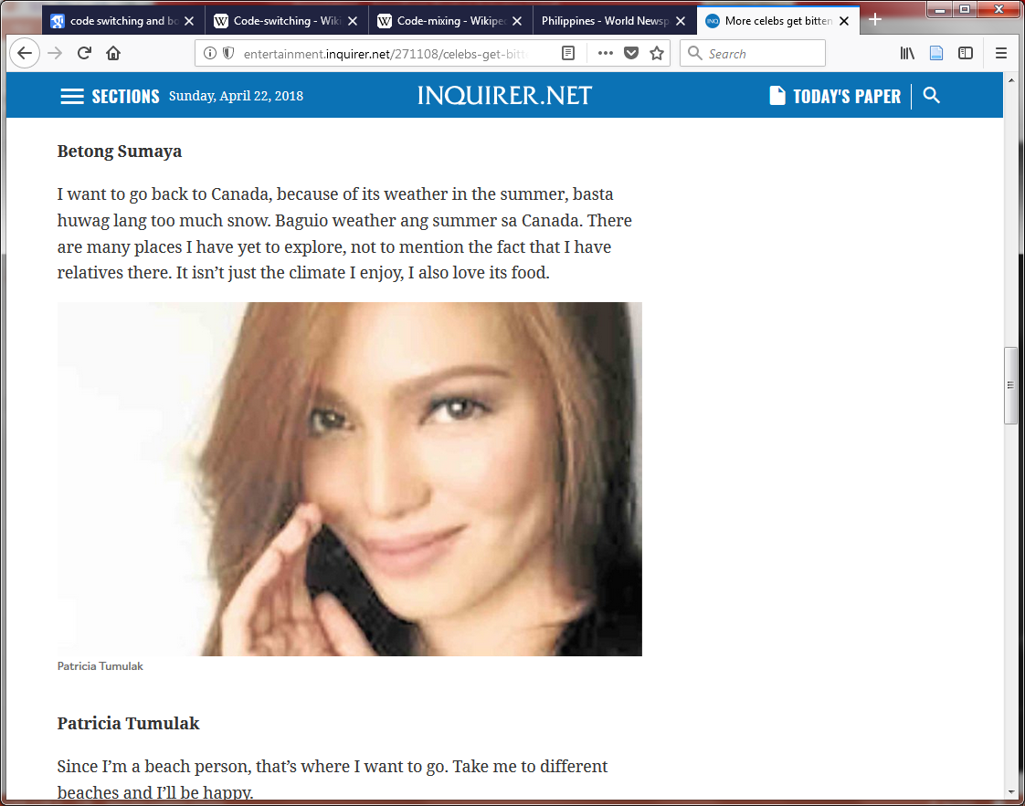
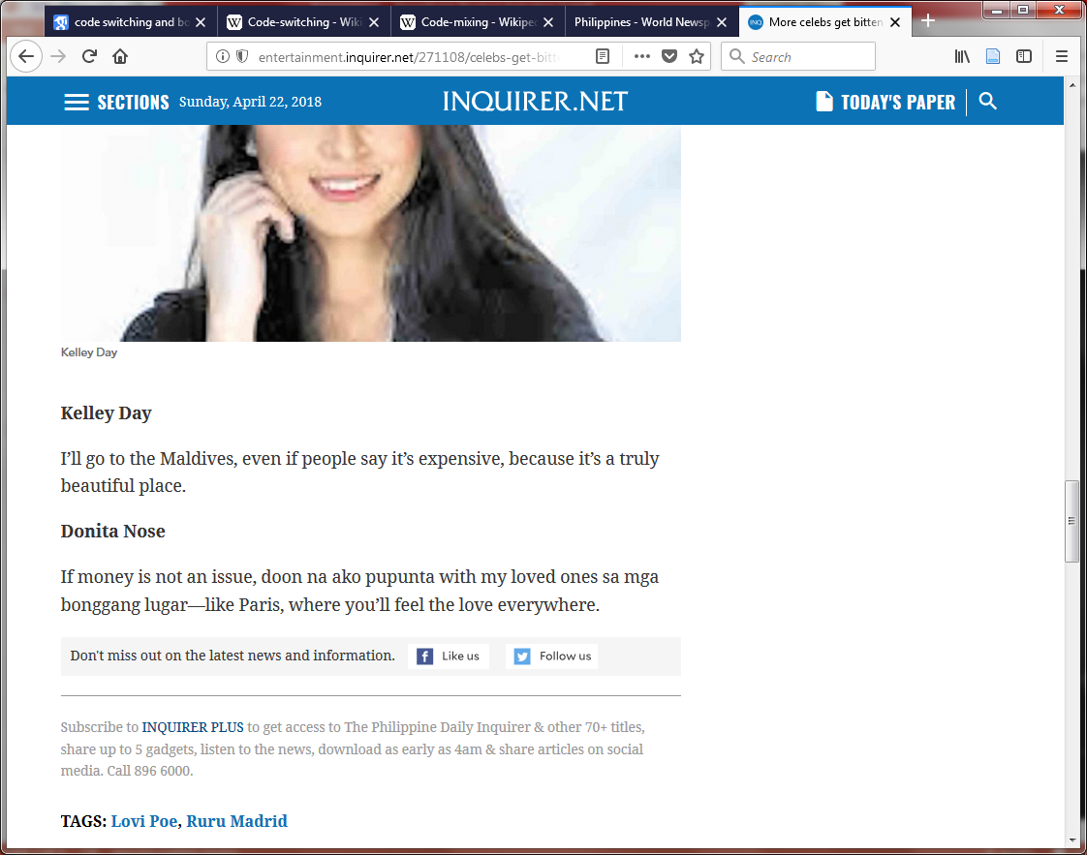
Philippine Inquirer, April 23, 2018. “Celebs get bitten by travel bug”, by Mary Ann Bautista

Slide 4
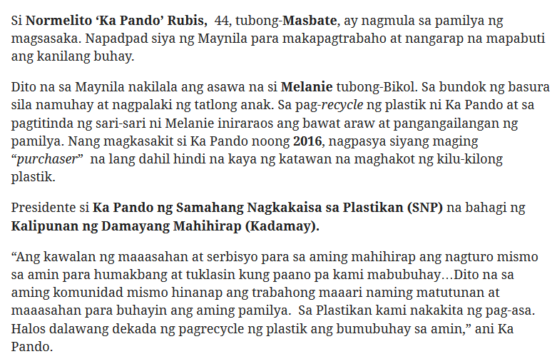
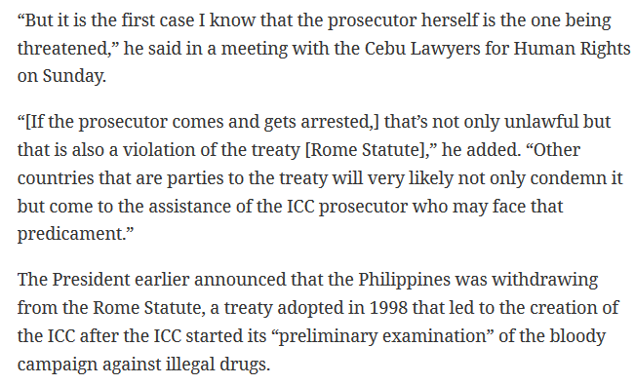
It’s a lot harder to find Taglish in “serious” news stories or novels
(scare quotes because women’s popular fiction is serious too…)
Pinoy Weekly, March 25, 2018. “Buhay at pagpupunyagi sa plastikan” by Iya Espiritu
Philippine Inquirer, April 23, 2018. “Arresting ICC prosecutor could get Duterte in more legal trouble, says lawyer” by Rosalie O. Obatayo

Slide 5
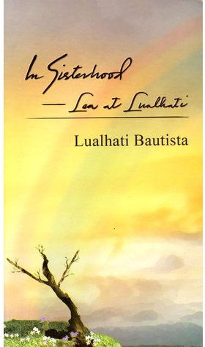
Even in a literary novel nominated for Filipino Readers’ Choice Award for “Fiction in Filipino/Taglish”, dialog is rather segregated

Slide 6
I want to push against the idea that mixed languages are not serious, not correct, not valuable

Slide 7
Why do we do it?
Le mot juste
Overheard in New York City:
Because her sister’s coming to pick her up at two o’clock daw

Slide 8
Why do we do it?
Just because?
A Nuyorican Spanglish example:
But I used to eat the bofe, the brain. And then they stopped selling it because tenían, este, le encontraron que tenía worms. I used to make some bofe! Después yo hacía uno d’esos concoctions: the garlic con cebolla, y hacía un mojo, y yo dejaba que se curare eso for a couple of hours.
from Shana Poplack . 1988. “Contrasting patterns of code-switching in two communities”. In Monica Heller (ed.), Codeswitching: anthropological and sociolinguistic perspectives. Waltery de Gruyter.

Slide 9
Why do we do it?
Just because?
There’s a lot more to it (e.g., Monica Heller, Ana Celia Zentella, Lucía Elías-Olivares, and many, many others)
marking identity
reinforcing group solidarity
avoid showing off ability in one or the other language
exploiting or challenging languages’ power associations, e.g. in the workplace

Slide 10

Why do we do it?
It’s natural
What makes bi/multi-lingualism good for our brains is that we’re constantly exercising executive control to make sure the right language comes out (e.g., Judith Kroll)
cat
pusa
gato
猫
Wikimedia commons: Cat silhouette.svg

Slide 11
Why do we do it?
It’s natural
When we know we’re among friends who speak the same languages, we can relax a little and not worry so much about what language comes out

Slide 12
Why do we do it?
Can code-switching be more inclusive/accessible?
Provides a safety valve for speakers who aren’t fully proficient
Nakalimutan ko ang kasi lahat ng mga conjugation rules
But also demands that listeners understand both languages

Slide 13
The linguistics of code-switching
Poplack’s biggest observation
Switches tend to occur at positions where the two language’s structures are equivalent
Eat now or else you will not get fat
Kumain ka na ngayon kundi hindi ka tataba
➔ Eat now or else hindi ka tataba
BAD: Eat now or else not ka tataba
Code-switching isn’t chaotic or random
examples from Wikipedia entry for Taglish

Slide 14
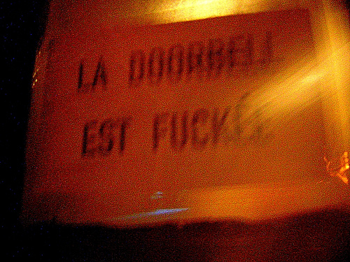
Franglais = français + anglais
Franglais is endemic to my hometown, Montreal
French-speaking city
65% mother tongue, 90% can speak
with a big English-speaking minority
10% mother tongue, 60% can speak
[approximate data from 2016 census]
A Franglais example I spotted on an apartment door years ago but neglected to take a picture of:
http://www.vagabondish.com/sign-la-doorbell-is-fuckee-montreal/

Slide 15
Franglais: it’s no Taglish!
Franglais tends to be very limited (examples from Shana Poplack chapter cited earlier):
mot juste: Je veux pas avoir des dishpan hands
explaining: J’ai acheté une roulotte, un mobile home là, une maison mobile
quoting: Je m’adresse en français, pis s’il dit “I’m sorry,” ben là je recommence en anglais
using English, but with overt signal: Mais je te gage par exemple que … excuse mon anglais, mais les odds sont là

Slide 16
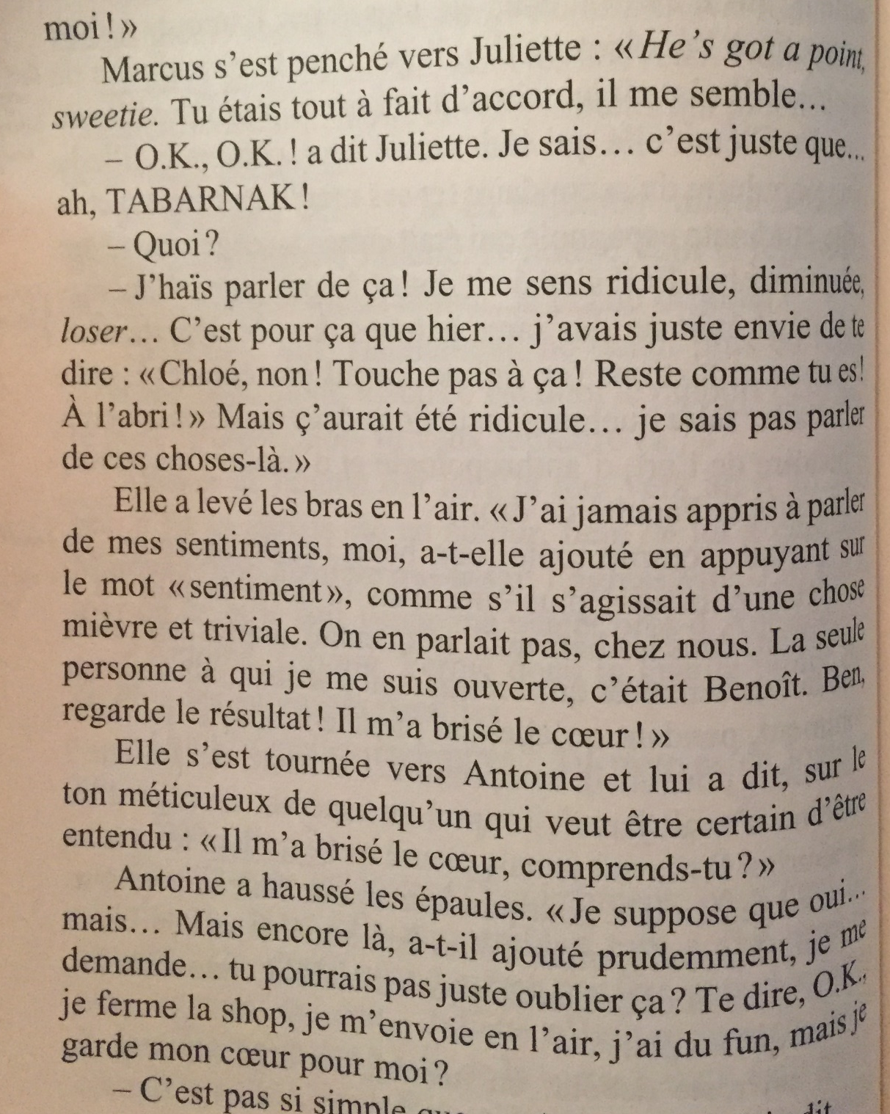

Even in a genre novel, use of English is limited and often italicized

Slide 17
Things might be changing
You won’t see it in the media, but more and more, you can overhear truly mixed conversations

Slide 18
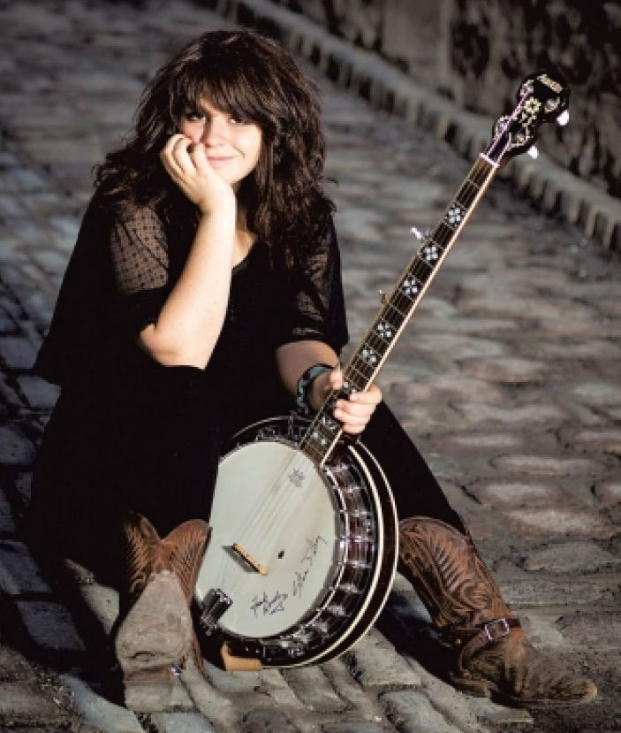
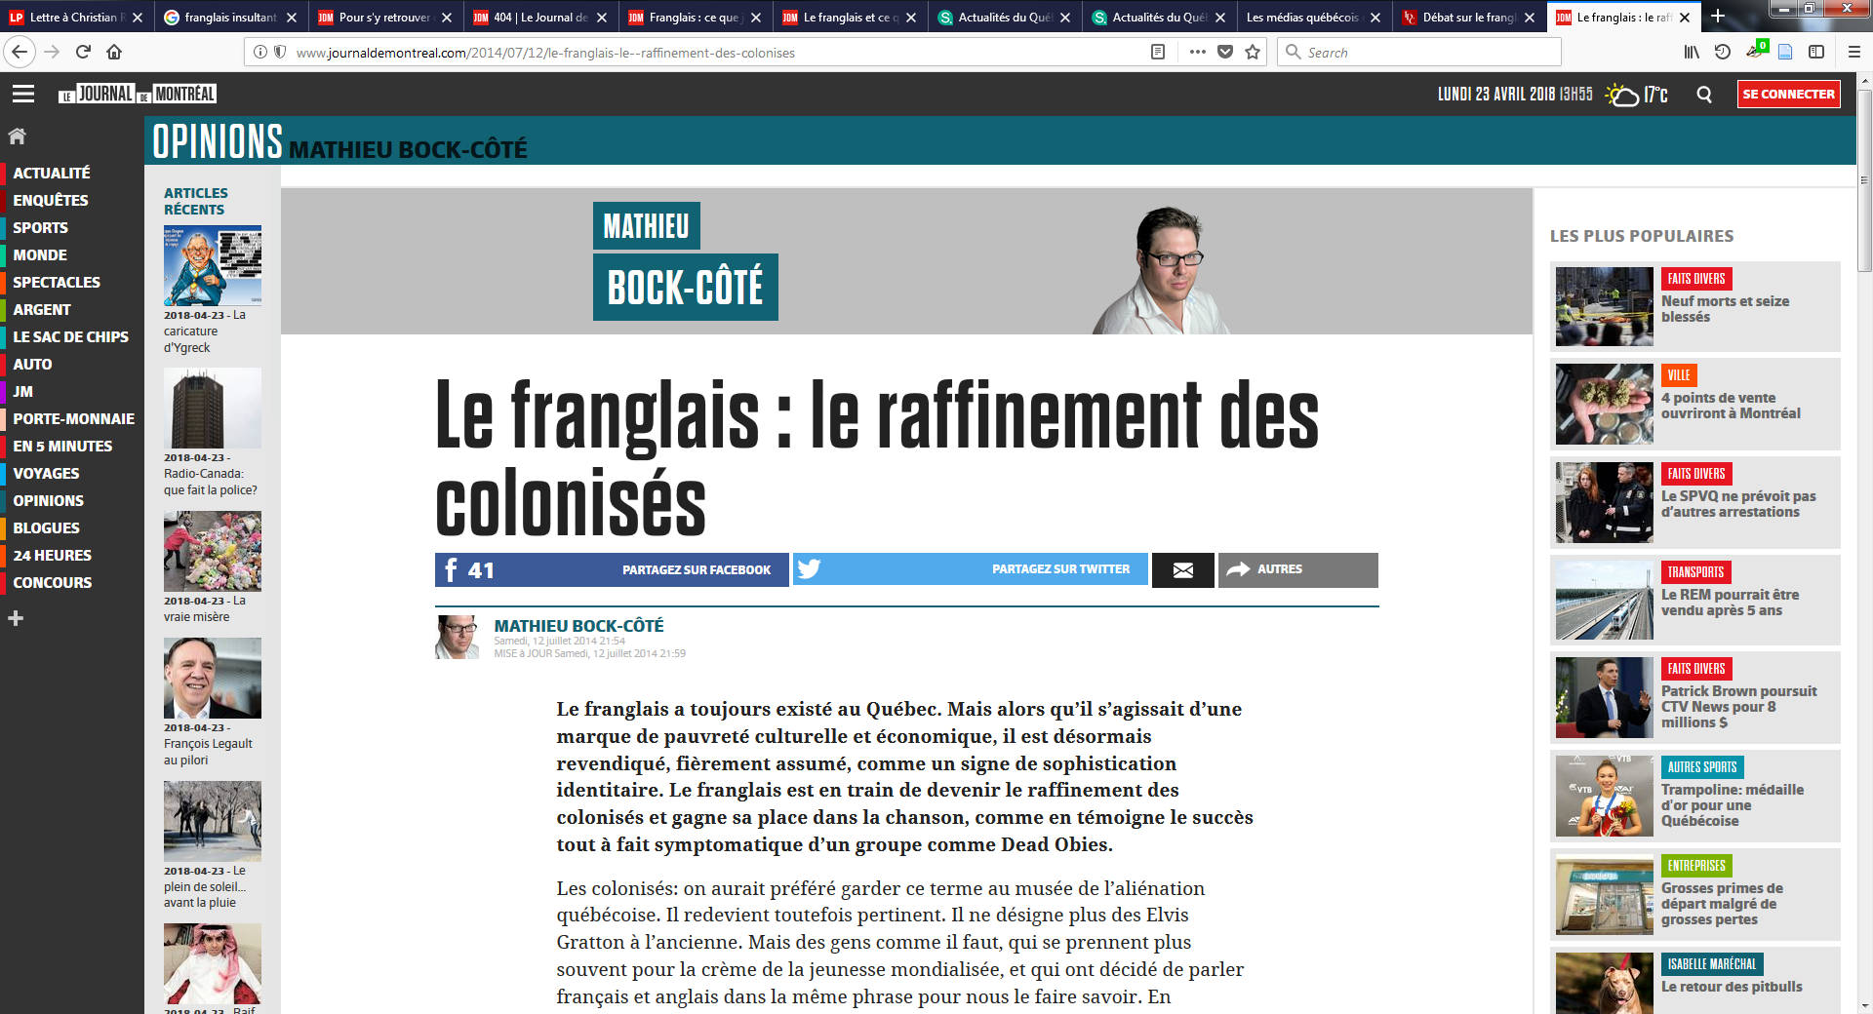
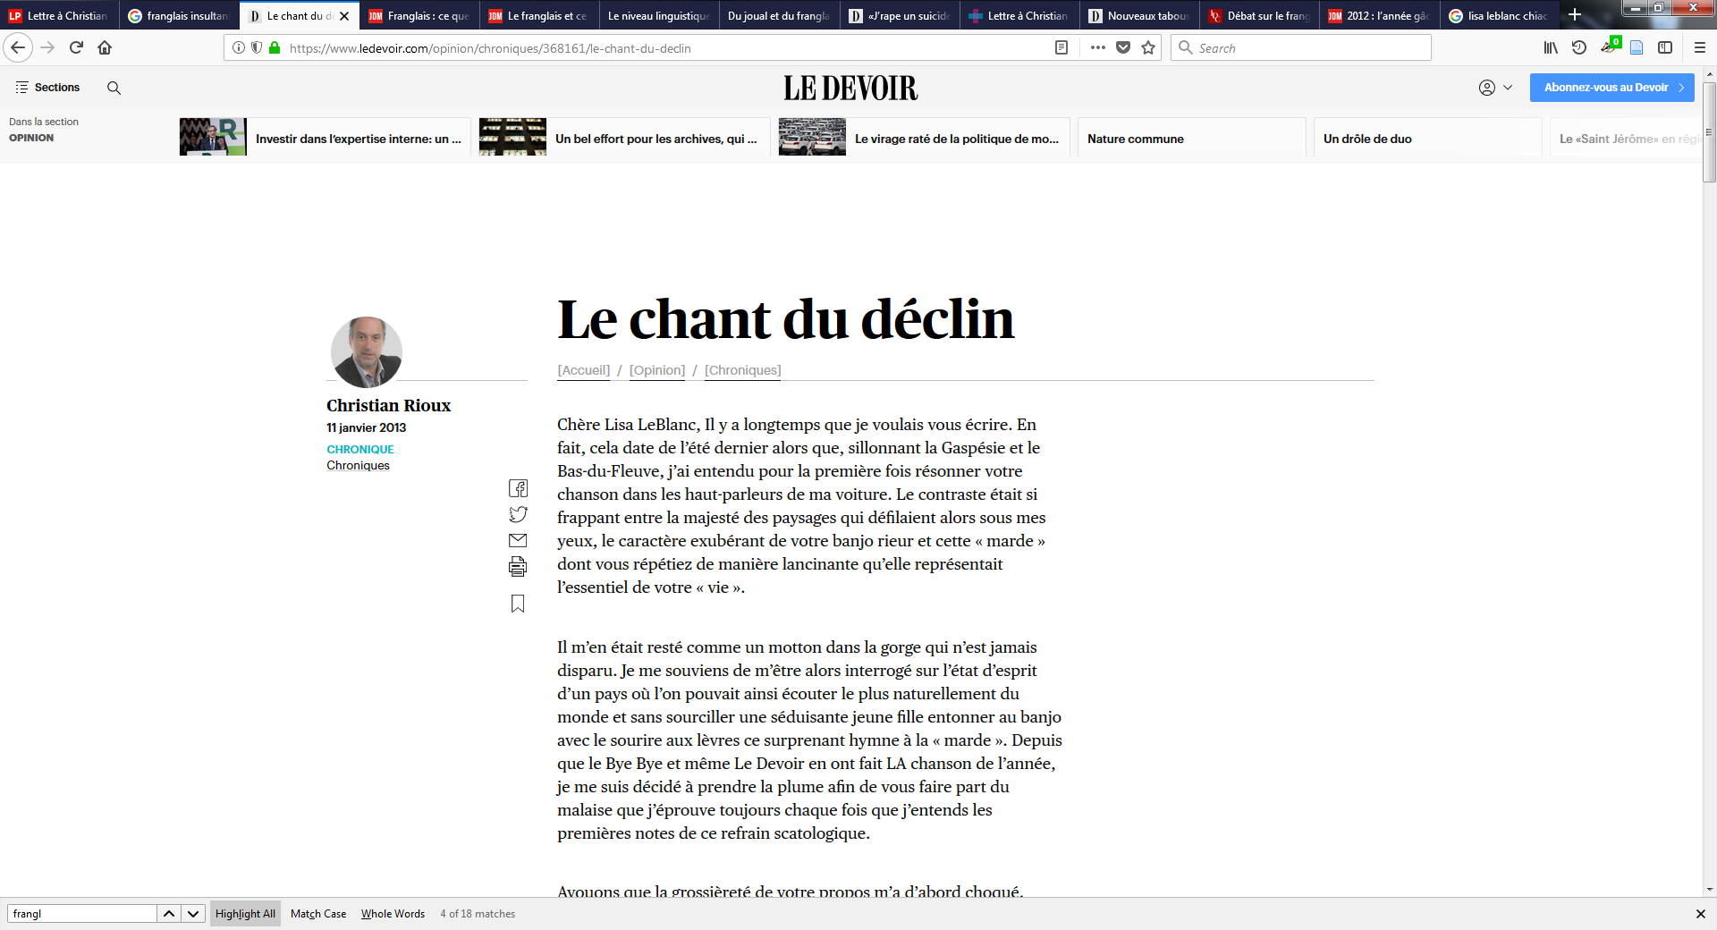
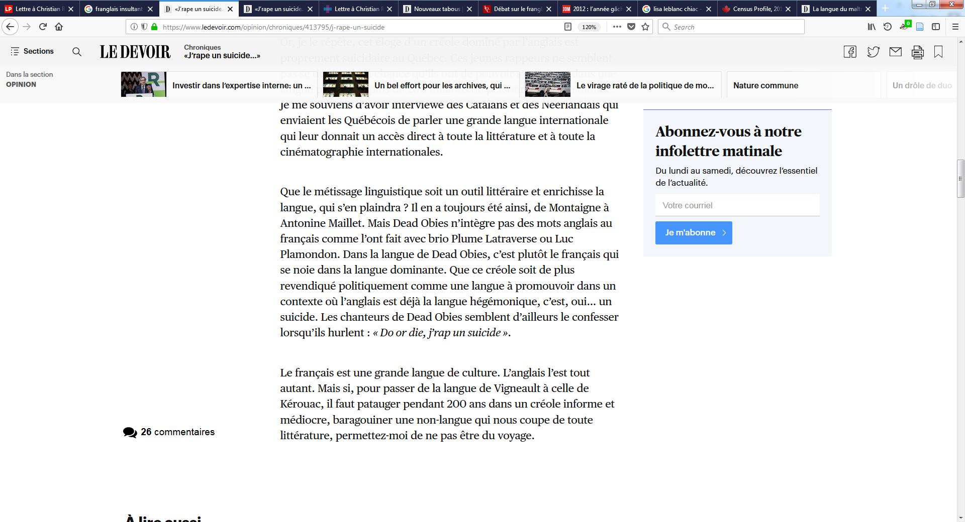
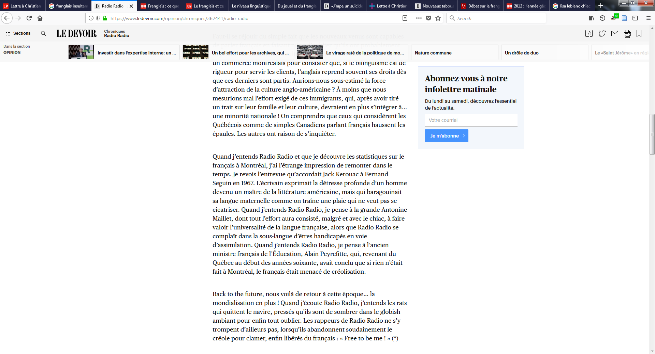
Some strong negative reactions!
One side of the media reactions to Franglais lyrics
about both joual (often-pejorative name for Montreal franglais) and chiac (often-pejorative name for New Brunswick franglais)
franglais: the refinement of the colonized
the song of decline
…a formless and mediocre creole, babbling a non-language
the sub-language of handicapped beings on their way to assimilation
Lisa LeBlanc. Photo: Mari-Hélène Tremblay, Le Devoir

Slide 19
The politics is different in every case
What’s the social and political status of each language?
Who is code-mixing by and for?
Who does it include and who does it exclude?
But for myself, I’ll continue to dream in Taglish, Spanglish, and Franglais
and I’ll be proud of our human ability to maintain open borders in our minds

